Slide 1
Multimedia Systems
Hardware & Software

Slide 2
Table of Content
Categories of multimedia systems
Categories of multimedia devices
Evolution of multimedia PC
Authoring tools
Classification of authoring tools
Multimedia development process

Slide 3
Multimedia Systems
Can be categorized based on functionality as
below:
Multimedia Presentation Systems (for user)
Multimedia Development Systems (for developer)

Slide 4
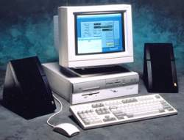
Multimedia Presentation Systems
PC with high resolution screen
CD-ROM drive
speakers and microphone

Slide 5
Multimedia Development System
Includes the following:
software toolkit for development work
software library for support functions
libraries of clip art, music and video
Related hardware

Slide 6
Multimedia Development System
My program works at my PC but not at the users!
Development systems has more resources and utilities.
Presentation systems must be checked to have the required components and resources.

Slide 7
Six Categories of Multimedia Devices
Analog Media Devices
Digital Media Devices
General Purpose Devices
Synchronization Devices
Interaction Devices
Multimedia Platforms

Slide 8
1. Analog Media Devices
These devices deal with analog media, but may be under computer control
Divided into 3 sub categories :
  Sources
  Filters
  Sinks

Slide 9
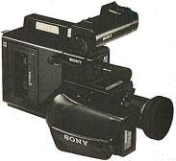

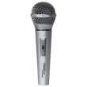
Sources (Analog Input)
Microphone
Video Camera
Photographic Camera

Slide 10


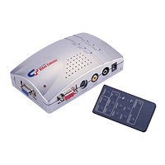

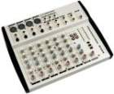
Filters (Analog Processing)
Analog Video Effects Device
Analog Audio Effects Device
Audio Mixer

Slide 11
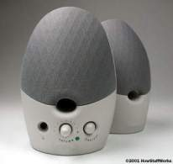
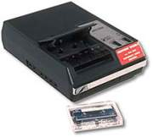

Sinks (Analog Output/Storing)
Speaker
Video Display
Video Tape Recorder
Audio Tape Recorder

Slide 12
2. Digital Media Devices
These devices deal with digital signal.
Can be divided into 3 sub categories :
  Capturing devices
  Processing devices
  Presentation devices

Slide 13
Capturing Devices (Input)
Keyboard
Image Scanner
OCR device

Slide 14
Processing Devices
Video Encoder/Decoder
Audio Encoder/Decoder
Digital Video Effects Device
Digital Audio Effect Device

Slide 15

Presentation Devices (Output)
Printer
Monitor
Projector

Slide 16
3. General Purpose Devices
Examples: storage devices like CD-ROM, floppy drive, hard drive, network interface, and general purpose processors
Most devices are digital

Slide 17
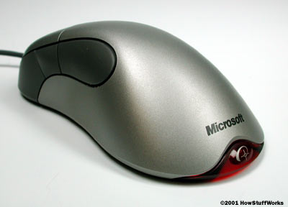
4. Interaction Devices
Multimedia application means ability to interact within the application itself
Interaction devices enable user direct control over the multimedia application behavior
Examples: keyboard, mouse, joystick, electronic pen

Slide 18
5. Synchronization Devices
Simultaneous presentation using multiple media (text,audio,video etc).
Requires hardware assistance to maintain proper timing.
Example: sync generator in audio and video studios, Macromedia Flash, computer games etc.

Slide 19
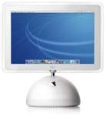
6. Multimedia Platform
A true multimedia platform integrates and combines various multimedia devices and components
Apple Macintosh
Popularized the graphical user interface
Popularized computer graphics
Native sound file formats (aiff & mid)
Native digital video file format (QuickTime)
IBM Compatible PC
Original emphasis was on business computing *

Slide 20
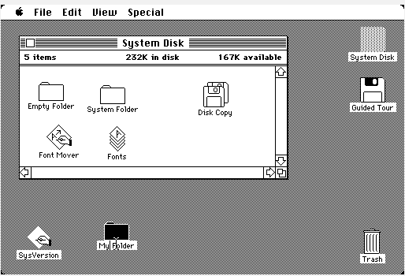
Evolution of Multimedia PC
The personal computer has gone through several stages in its short lifetime.
Early systems supported only alphanumeric data and employed a simple command line interface.
Next generation supported text and simple graphics, which could be accessed via a menu-driven interface.

Slide 21
Evolution of Multimedia PC
Limitations of PC of the 1980’s
The basic IBM-PC-compatible machine was weak on processing power and had no integral support for audio and video; use adapter boards for AV.
Extensions to the operating system were also required to control various external equipments like microphones, audiotapes, VCRs and video cameras. (Now we have System software like Microsoft Multimedia Extension for windows)

Slide 22
Evolution of Multimedia PC
Limitations of PC of the 1980’s
Probably the weakest feature of PC in context of Multimedia is the bus architecture.
  Data bus: internal communication line carries data
  between components within / different PCs.
  Existing bus architecture (ISA bus) handles small packets
  of data, in bursts with error checking.
  Now, PC have Peripheral Component Interconnect (PCI);
  use 3 basic types of bus – increase speed.
  (control, address, transfer).

Slide 23
Evolution of Multimedia PC
Limitations of PC of the 1980’s
Networking to transmit multimedia information requires multiplexing / demultiplexing software;
requires extra processing in computers and
possible extensions to the OS.

Slide 24
Evolution of Multimedia PC
Big industry of adapter boards and related equipment for multimedia applications grew up around IBM PC and its clones.
In order to standardize the developments relating to multimedia PC (MPC), the software publishers association (SPA) set up its subsidiary called MPC marketing council in the early 1990s.
A certification procedure has also been developed allowing members to attach a special logo to their products provided compatibility conditions are met. Recently a software and information industry association (SIIA) has also been formed (http://www.siia.Net).

Slide 25
Evolution of Multimedia PC
For hardware products , compatibility means compliance with the MPC hardware requirements and for the software products this means the ability to run on an MPC platform.
MPC level 1 specs were meant to energize the adoption of a standard multimedia computing platform.
Revised specs called MPC level 2 or simply
MPC2 were introduced in May 1993 to
establish a performance standard to enhance multimedia computing.

Slide 26
Evolution of Multimedia PC
In 1995 the MPC level 3 specifications were
announced once again raising the standard
for multimedia PCs.
Both MPC2 and MPC3 maintain backward
compatibility.

Slide 27
MPC Level 1
Adopting standard computing platform as an
extension of personal computer.
Includes CD-ROM, audio subsystem and I/O
requirements.
Most MPC level-1 were sold as upgrade for existing
Computers. (Intel 386 / 486)

Slide 28
MPC Level-2
MPC-1 cost too much $ , too little capabilities.
MPC Level-2 introduced in May 1993.
Design includes software based Video and new
applications (Photo CD ).
Backward compatibility with MPC-1

Slide 29
The Emergence of MPC
 | MPC I | MPC II | MPC III
CPU | 386sx (16Mhz) | 486sx (25Mhz) | Pentium (75 Mhz)
Memory | 2 MB | 4 MB | 8 MB
HD drive | 30 MB | 160 MB | 500 MB
Sound | 8 bit + MIDI | 16 bit + MIDI | 16 bit + MIDI
Video -resolution - number of colors | VGA 640 x 480 256 (8 bit) | SVGA 640 x 480 65K (16 bit) | SVGA + MPEG I 640 x 480 65K (16 bit)
CD-ROM -speed -seek time | 150 Kb/s 600 ms | 300 Kb/s 400 ms | 600 Kb/s 280 ms

Slide 30
Evolution of Multimedia PC
Desktop Intel® Core™ Duo Intel® Pentium® Extreme Edition Intel® Pentium® D Intel® Pentium® 4 Extreme Edition HT Intel® Pentium® 4 HT Intel® Pentium® 4 Intel® Celeron® D Intel® Celeron® Laptop Intel® Core™ Duo Intel® Core™ Solo Intel® Pentium® M Mobile Intel® Pentium® 4 Intel® Celeron® M Server Intel® Itanium® 2 Intel® Xeon® Intel® Xeon® MP Intel® Pentium® D Intel® Pentium® 4 HT Intel® Pentium® 4 | Workstation Intel® Xeon® Intel® Pentium® D Intel® Pentium® 4 HT Intel® Pentium® 4 Wireless Intel® Application Processors Intel® Cellular Processors Network Intel® IXP465 Network Processor Intel® IXP460 Network Processor Intel® IXP425 Network Processor Intel® IXP422 Network Processor Intel® IXP421 Network Processor Intel® IXP420 Network Processor Intel® IXP2855 Network Processor Intel® IXP2805 Network Processor Intel® IXP2400 Network Processor Intel® IXP2325 Network Processor Intel® IXP2350 Network Processor Intel® IXP1200 Network Processor | Embedded Intel® Architecture Processors Intel® Xeon® Processors Intel® Pentium® M Processors Intel® Pentium® 4 Processors Intel® Pentium® III Processors Intel® Pentium® II Processors Intel® Celeron® M Processors Intel® Celeron® Processors Intel® Pentium® Processors MMX™ Intel® Pentium® Processors Intel486™ Processors Intel386™ Processors Intel® 186 Processors Intel® Application Processors Intel® PXA270 Processor Intel® PXA255 Processor

Slide 31
Authoring tools
An authoring tool is a software package which allow developers to write hypertext and multimedia applications by linking together objects such as a paragraph of text, an illustration, graphics or a song.
It is an authoring system intended for use by a user who are not traditional programmer or even do not know any programming language but wish to create interactive multimedia presentations or product or computer based learning material.
Example: Macromedia Flash, Dreamweaver, Power Point, etc.

Slide 32
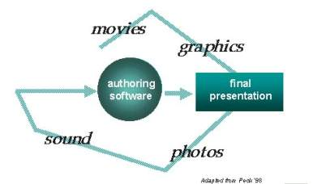
Role of authoring software
Produce content with:
  Paint, text, animation tools
Incorporate and combine contents
Design screen layouts using templates
Create interactivity
Create hypertext

Slide 33
Products developed with authoring software
Multimedia presentations
E- Learning
Computer Based Training (CBT)
Web pages
Artistic visualizations

Slide 34
Classifying multimedia authoring tools
There are two primary ways of classifying
multimedia authoring tools:
  by metaphor
  by capabilities and complexity

Slide 35
Classifying by Metaphor
All multimedia tools are based on a metaphor. The
metaphor is based on three main characteristics:
  the way the program organizes the different elements
  the way the program sequences events that happen
  the way the application is delivered
Most authoring programs are based on one of the following metaphors:
  1. Time-based
  2. Card-based or Page-based
  3. Icon-based, event-driven (logic flow)
  4. Theatrical-based

Slide 36
1. Time-Based Metaphors
In time-based authoring programs, the elements of the program are organized along a time line. Events may be precisely synchronized by coordinating the time, speed and display length of each one.
Examples of time-based authoring programs include:
  Astound by Gold Disk http://www.golddisk.com/astound.html
  MacroMedia Flash by Macromedia http://www.macromedia.com
  Cinemation from Vividus http://www.vividus.com/

Slide 37
2. Card/Page -Based Metaphors
In card-based and page-based authoring programs, the metaphor is one of a stack of cards or the pages of a book. Unlike the real paper item, however, the user is not limited to going through the program sequentially. It is easy to move from page to page because most programs use buttons and hot spots which allow the user to choose their own path.
A card-based program usually allows common elements, such as backgrounds and navigation bars which are common to all cards, to be placed in a background layer and elements which are different on each card to be placed on a foreground layer.

Slide 38
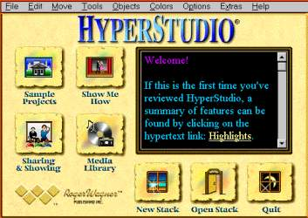
Examples of card-based programs include:
HyperCard by Apple Computer
HyperStudio by HyperStudio
Asymetrix Toolbook by Asymetrix
SuperCard by Allegiant

Slide 39
3. Icon-Based Metaphors
Icon-based authoring programs are designed around a visual programming approach to sequencing the events in the multimedia application. The developer drags the icons for each event, such as text, graphics, sound and video, to a flow line thus also creating a type of visual flow chart. Icons may be rearranged by dragging them to the desired position.
Examples of icon-based authoring programs include:
  Macromedia Authorware by Macromedia
  IconAuthor by Aimtech

Slide 40
4. Theatrical-Based Metaphors
In this type of authoring program, events are thought of as cast members and arranged in a theatre-like production or stage which combines these elements in regard to time and place.
Examples of theatrical-based authoring programs include:
  Macromedia Director by Macromedia

Slide 41
Classifying By Capabilities and Complexity
Multimedia authoring programs may also be categorized according to their capability and degree of complexity. Most authoring programs may be placed in one of these categories:
  1. Multimedia-Capable Presentation Tools
  2. Dedicated Media Integration Tools
  3. Professional Multimedia Development Tools

Slide 42
1. Multimedia-Capable Presentation Tools
Slide presentation software: PowerPoint
Semi to non-professional applications
Mostly for educational or training purposes
Usually very efficient at integrate charts, graphs, and simple illustrations.
Examples include:
    Microsoft PowerPoint
    Adobe Persuasion
    Lotus Freelance Graphics
    WordPerfect Presentation
    Software Publishing's Harvard Graphics

Slide 43
2. Dedicated Media Integration Tools
Sequence multimedia events and elements.
Semi to full professional use
Examples:
  IBM's Storyboard Live!
  Asymmetric's Media Blitz!
  Passport Producer

Slide 44
3. Professional MM Development Tools
Highly interactive applications such as :
  games
Full professional use
Programming/scripting capabilities
Examples:
  Macromedia Director, Authorware, Flash
  Asymmetric's Toolbook
  Apple's HyperCard
  Aimtech's IconAuthor

Slide 45
Multimedia Development Process
Take a long time to be produced.
Include four stages:
  Planning and costing
  Designing and Producing
  Testing
  Delivering

Slide 46
Planning and Costing
Plan to fulfill the expectation of the audience.
Steps to start a project:
  Define the objectives and scope
  Target audience
  Set the content
  Estimating cost
  Hardware
  Software
  Build a multimedia team

Slide 47
1. Define the objectives and scope
What is the purpose of creating the project?
Try to achieve the objective.
Define the scope or the boundary of the project.
Consider how much time to develop the project.
Consider the knowledge and skills needed
Consider the how to organize the project

Slide 48
2. Target audience
Target audience – applications users or information recipient.
To whom the project is created for
Do some background research about
  the target audience because this will affect
  the complexity of your design.
Consider the following factors:
  Age
  Knowledge or educational background
  Technological background
  Language
  Gender
  Economical background
  Profession

Slide 49
3. Set the content
Content or information will determine the size of the project
Content production depend on the availability of the existing resources or the need to create new materials.
Consideration before determining the content are:
  Obtaining rights to use exiting resources.
  Digitizing pictures, audio, and video.
  Produce materials including text, graphics, audio effects and animation
The amount of information available must be based on the audience expectation.

Slide 50
4. Estimating cost
Three general elements that can vary in project estimates: time, money and people. If we decrease any of these elements, we may generally increase one or both of the others.
Time
Money
It will take longer time to develop multimedia application if developer
team (people) and money is less.
If there is a large number of developer
team, time and money (cost) to develop multimedia application could be reduced.
People
Money
Time
People
Money (cost) can be saved if
we decrease the number of
developer team and time
duration in multimedia
application development.
Time
Money
People

Slide 51
5. Hardware Requirement
Developer side.
It is also for the end user expectation – the type of hardware platform.
Several types of hardware components that need to be considered:
  Memory and storage device
  Input devices
  Output devices
  Communication Device (optional)

Slide 52
Output device
The size of the monitor also should be considered because larger monitor gives the user larger view and this makes creating graphics easier.
Projectors suitable in briefing or educational multimedia products where the information is displayed to a large number of viewers.
Note that displaying information with projectors may not be the same as displaying on monitors because information such as text must be large enough and have contrast color so that it is easier to read.

Slide 53
6. Software requirement
Expensive software offer advance and powerful features which requires higher skill. However, there are software that can help to save time and to organize a project which are less expensive.
Several types of software:
  Text Editing and Word Processing Tool
  Painting and Drawing Tools
  3D Modeling and 2D Animation Tools
  Image Editing Tools
  Sound Editing Tools

Slide 54
7. Build a multimedia team
Require a specific set of skills.
Most of the time, multimedia project involves a lot of people to be produced. Each person has their own specialized skills required to do specific task.
The examples of multimedia team members and their roles:
  Project Manager
  Multimedia Designer
  Audio/Video specialist
  Multimedia programmer

Slide 55
Multimedia team
Project Manager
The leader of a project.
Responsible for overall development, implementation of the project and day to day operations.
Strong in both technical and management aspect of the
project.
Multimedia Designer
Deals with visual aspects of the project, graphic design, illustration, animation, interface design and image processing.
Maintain the flow of the information, clear and consistent navigation.

Slide 56
Multimedia team
Audio/Video specialist
Focus on the audio and video production - shooting, capturing and editing video, digitizing and audio recording.
Multimedia programmer
Responsible for integrating all the multimedia elements using authoring system or programming language to create a functioning and useful multimedia product.

Slide 57
Testing
Unavoidable rule in any multimedia projects.
Test or review the project or Web site to ensure it is bug free, accurate, operationally and visually on target, and achieving the objective or target.
Every feature and function must be exercised, every button or link must be clicked - will be repeated again and again with different hardware and under various conditions
Two phases of testing
  Alpha testing
  Beta testing

Slide 58
Alpha testing
Often performed only by users within the organization developing the software as a form of internal acceptance testing.
The product is evaluated relatively in the early stage of the development phase.
The application may be missing part of the content or functionality.
The main interest is to review the concept, format, user interface and the layout.
The tester may be selected users or friends, most - often the team member themselves - should be able to provide positive criticism or feedback.

Slide 59
Beta testing
The product is evaluated just before the final release.
It is a fully functioning product and should be relative bug free.
Main interest is to find bugs or content errors.
The testing group should be represented by the real users and should not include the people who have been involved in the project.
The feedbacks from these testers are very important where the errors or problems reported by the beta testers have to include the detail description of the problem.

Slide 60
Delivering
Final stage
Know the medium you want to use.
Web site: can just upload to the servers and adjust some settings then it is ready.
For more complex application where installation into the user’s computer is needed. Installation should be smooth, easy and fast.
Documentation - need to provide a clear step-by-step procedure for the users to follow.
Troubleshooting guide - potential problem that can occur and how to solve it.
A file name README.TXT is good thing to include in the CD distribution of your project.

Slide 61
Delivering medium
CD-ROM
It is also an optical storage and considered the most common form of packaging for multimedia products.
It started out as a read-only technology in which user could store data once only and access it many times.
Recent technology led to a multi-session version where user can add to the content of a CD and even fully able to write to the systems.

Slide 62
Continued…
DVD
It is the latest format for optical storage up to 17GB.
At the moment, DVD is increasingly popular for
DVD-Video for its high quality audio and video.

Slide 63
Summary
2 categories of multimedia systems
- Multimedia presentation systems
- Multimedia development systems
6 categories of multimedia devices
- Analog devices
- Digital devices
- General purpose devices
- Synchronization devices
- Interaction devices
- Multimedia Platforms
Evolution of multimedia PC
Authoring tool is a software package which allow developers to write hypertext and multimedia applications by linking
together objects such as a paragraph of text, an illustration,
graphics or a song.

Slide 64
Summary
Classification of authoring tools
- by metaphors:
Time-based
Card/page-based
Icon-based
Theatrical-based
- by capabilities and complexity:
  Multimedia-Capable Presentation Tools
  Dedicated Media Integration Tools
  Professional Multimedia Development Tools
Multimedia development process
- Planning and Costing
- Designing and Producing
- Testing
- Delivering

